Slide 1
Product Repairs Analysis
Project presentation
By – Hariom Rai

Slide 2
Contents
Introduction
Data Collection and Cleaning
Exploratory Data Analysis
1. Which product type has the highest number of warranty claims?
2. What is the most common issue reported by customers for each product type?
3. Plot the graph for medium of contact
4. Find any Corelation in the dataset
5. Plot the graph for types of repair
6. What is the average agent tenure in days for each product type?
7. What is the trend in the number of warranty claims over time?
8. Are there any specific regions that have a higher number of warranty claims than others?
9. Is there a relationship between the number of parts sent and the product type?
10. What is the distribution of contract start and end dates?
11. Is there a relationship between the number of parts sent and the repeat count for each product type?
12. Is there a relationship between the number of parts sent and the repeat count for each product type?
Summary

Slide 3
Introduction
This project aims to analyze customer service data from an electronics company to gain insights into customer issues, product performance, and customer satisfaction. The dataset contains information on product type, issue type, repair type, repeat count, number of parts, and various dates. Exploratory data analysis techniques, including data visualization are used to identify patterns, trends, and relationships in the data. The insights gained from the analysis can help the company improve its products and customer service by addressing common issues, reducing repair times, and enhancing customer satisfaction.

Slide 4
Data Collection and Cleaning Steps
Importing libraries
Pandas
Matplotlib
Seaborn
Makeing a copy of dataset
Creating a copy of the dataset is a good practice to avoid accidentally modifying the original data. By creating a copy, we can work on the data without affecting the original dataset. This is particularly important when we are cleaning, transforming, or processing the data. If we make any mistakes during the analysis, we can simply discard the copy and start over again with the original dataset. It also helps to keep the code more organized and easier to read.

Slide 5
Data Collection and Cleaning Steps
DROPING DUPLICATES
CHANGING DATATYPE
FILLING NULL VALUES
FILLING NULL VALUES OF REGION COLUMN BY MODE
FILLING NULL VALUES OF PRODUCT_TYPE COLUMN COLUMN BY MODE
FILLING NULL VALUES OF AGENT_TENURE_INDAYS COLUMN BY MEDIAN
FILLING NULL VALUES OF CONTACT_TYPE COLUMN BY MODE
FILLING NULL VALUES OF COUNTRY COLUMN BY CATEGORY MODE(REGION)
FILLING NULL VALUES OF ISSUE_TYPE COLUMN BY CATEGORY MODE(PRODUCT TYPE)

Slide 6
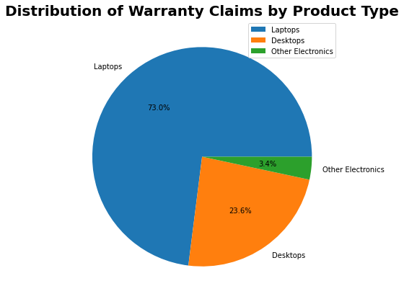
1. Which product type has the highest number of warranty claims?
Product type with the highest number of warranty claims: Laptops
The product type with the highest number of warranty claims can give insights into which product line needs the most attention for improvements or quality control. This information can be used to prioritize resources towards improving that particular product line to reduce warranty claims, increase customer satisfaction, and ultimately drive revenue growth.

Slide 7
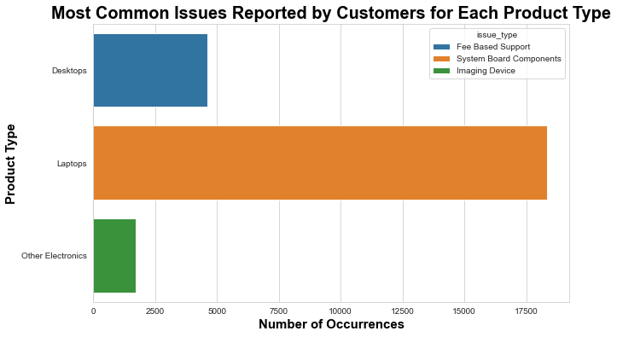
2. What is the most common issue reported by customers for each product type
This information can be useful for identifying areas that may require improvement in the product design or manufacturing process. It may also help customer service representatives to better understand and anticipate the types of issues that customers are most likely to encounter with each product type.

Slide 8
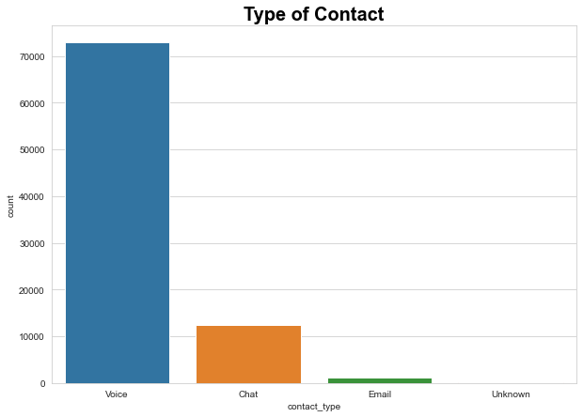
3. Plot the graph for medium of contact
The observation made from this countplot is that the company might need to ensure that their voice support is robust and efficient since it is the most popular way of contacting the company. They could also consider improving their chat and email support to cater to more customers.

Slide 9
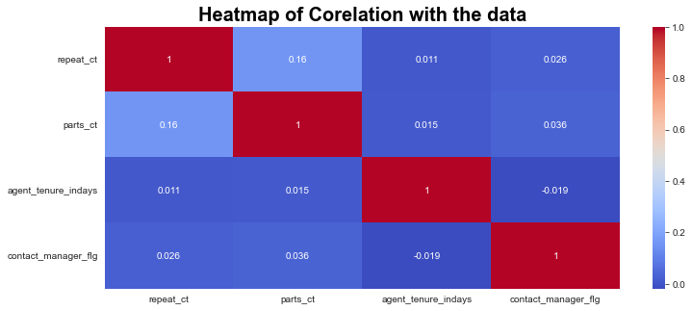
4. Find any Corelation in the dataset
The observation from the Heatmap is that there is a weak positive correlation between 'repeat_ct' and 'parts_ct', while there is no significant correlation between 'agent_tenure_indays' and any other variable. Additionally, there is a weak positive correlation between 'parts_ct' and 'contact_manager_flg'.

Slide 10
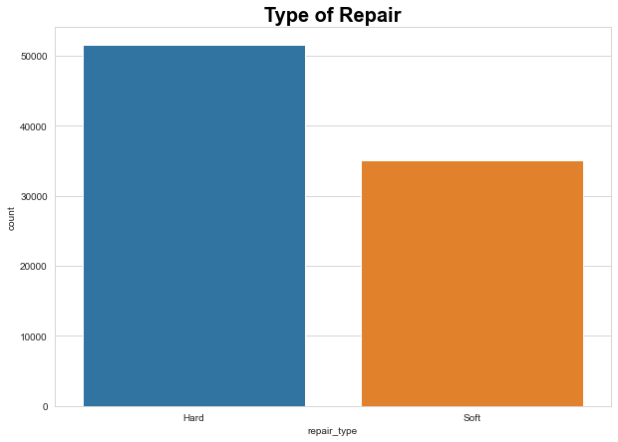
5. Plot the graph for types of repair
The resulting plot shows that the most common type of repair is "Hardware," followed by "Software". This information could be useful for identifying areas where the company might want to focus its efforts, such as investing in more hardware repair specialists or developing more robust software repair solutions.

Slide 11
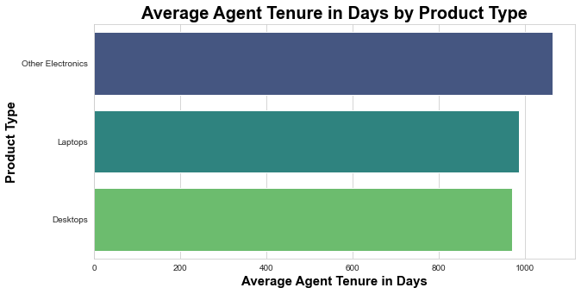
6. What is the average agent tenure in days for each product type?
The result shows the average agent tenure in days for each product type, calculated using the groupby() function. The product type with the highest average agent tenure is "Other Electronics" with 1063.14 days, followed by "Laptops" with 984.90 days, and "Desktops" with 970.13 days. This information can be useful for identifying patterns in agent tenure across different product types and potentially improving training or support for agents working with certain products.

Slide 12
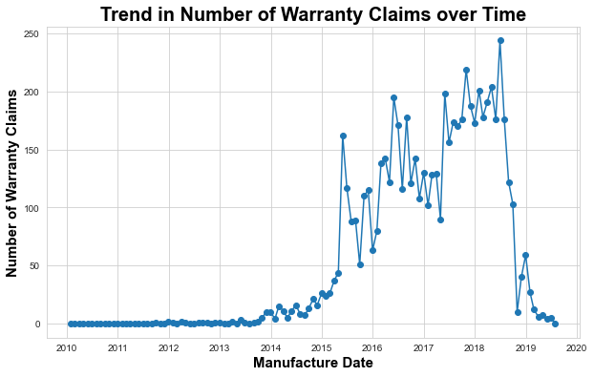
7. What is the trend in the number of warranty claims over time?
The line chart shows the trend in the number of warranty claims over time. It appears that there is a significant increase in the number of warranty claims in the early months of 2014, And reaches its peak on mid 2018. After that, there is a gradual decline in the number of claims until the end of the year. Overall, the trend indicates that there may be some issue with the products manufactured during the early months of 2014, which led to a surge in warranty claims.

Slide 13
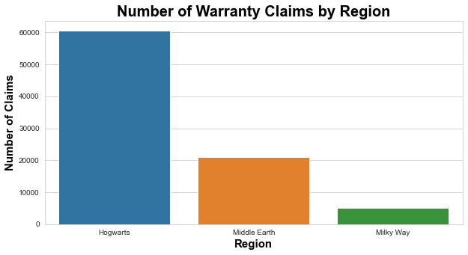
8. Are there any specific regions that have a higher number of warranty claims than others?
The output will shows a bar chart of the number of warranty claims by region, where "Hogwarts" has the highest number of warranty claims (60,541), followed by "Middle Earth" (20,904) and "Milky Way" (5,091).

Slide 14
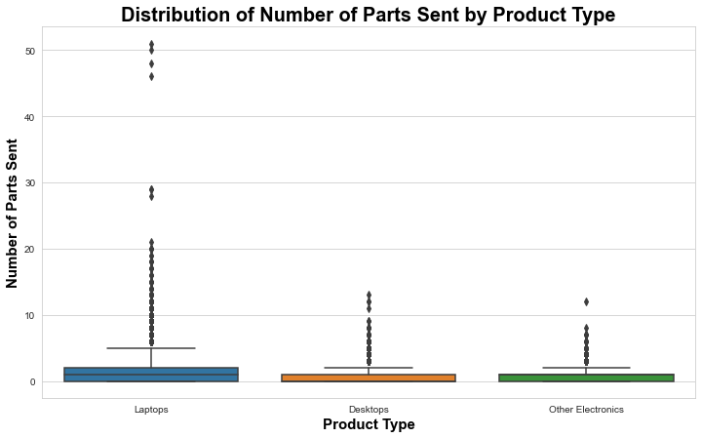
9. Is there a relationship between the number of parts sent and the product type?
The box plot shows that laptops have the highest median number of parts sent, followed by desktops and other electronics. Laptops also have a wider range of parts sent values, with more outliers compared to the other two product types. Overall, the distribution of parts sent values for desktops and other electronics are similar.

Slide 15
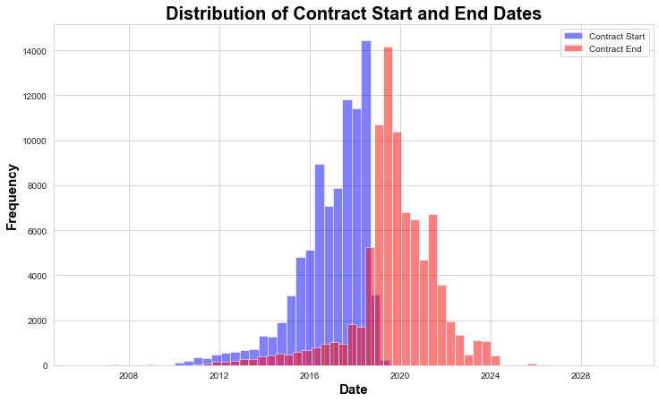
10. What is the distribution of contract start and end dates?
The output generates a histogram of the contract start and end dates for the dataset. The blue bars represent the frequency of contract start dates and the red bars represent the frequency of contract end dates. The graph shows that the contract start and end dates are mostly concentrated within the range of 2016 to 2022. However, there are some contracts that started or ended in earlier or later years as well. Overall, the distribution of contract start and end dates is relatively even, indicating that contracts have been signed and ended at a relatively steady pace throughout the dataset's time range.

Slide 16
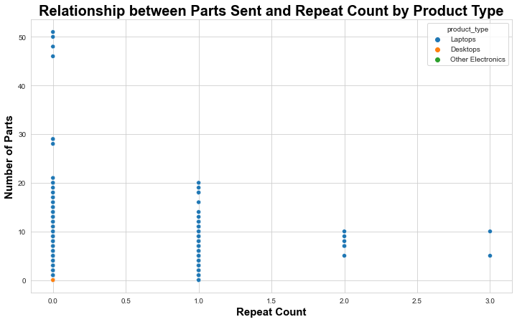
11. Is there a relationship between the number of parts sent and the repeat count for each product type?
The scatterplot shows the relationship between the number of parts sent and the repeat count for each product type. But the relationship is shown on Product_type of laptop only. And others product_type don’t have relationship. Each product type is represented by a different color. So Overall, there seems to be a positive relationship between the number of parts sent and the repeat count, with higher repeat counts associated with higher numbers of parts sent but only for laptop.

Slide 17
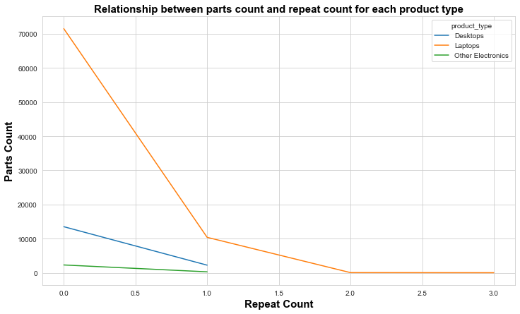
12. Is there a relationship between the number of parts sent and the repeat count for each product type?
The line chart shows the relationship between parts count and repeat count for each product type. Desktops have a lower parts count than laptops and little heigher than other electronics. Laptops have a slight increase in parts count as repeat count increases, while other electronics have a small parts count increase for repeat count of 1.

Slide 18
Summery
This project aimed to analyze the customer repair data of a large electronics company and gain insights into the repair patterns and product performance. After performing exploratory data analysis, we found that laptops were the most common product type requiring repairs, followed by desktops and other electronics. We also observed that customers with more repeat repairs tended to have more parts involved in their repairs.
Through analyzing the issue types, we identified that hardware issues were the most common cause for repairs across all product types. Additionally, we found that power-related issues were the second most common cause of laptop repairs, while software-related issues were the second most common cause of desktop repairs.
We also discovered that there were a few agents who handled a disproportionately large number of customer contacts, which could indicate potential issues with agent workload management.
Finally, by examining the distribution of contract start and end dates, we identified that there was a significant increase in the number of contracts expiring in the near future, which could suggest a potential increase in repair demand in the coming months.
Overall, this project provided valuable insights into customer repair patterns and product performance, which could help the electronics company make informed decisions related to product design and customer service.

Slide 19
Thank You

